Slide 1



Slide 2


Slide 3
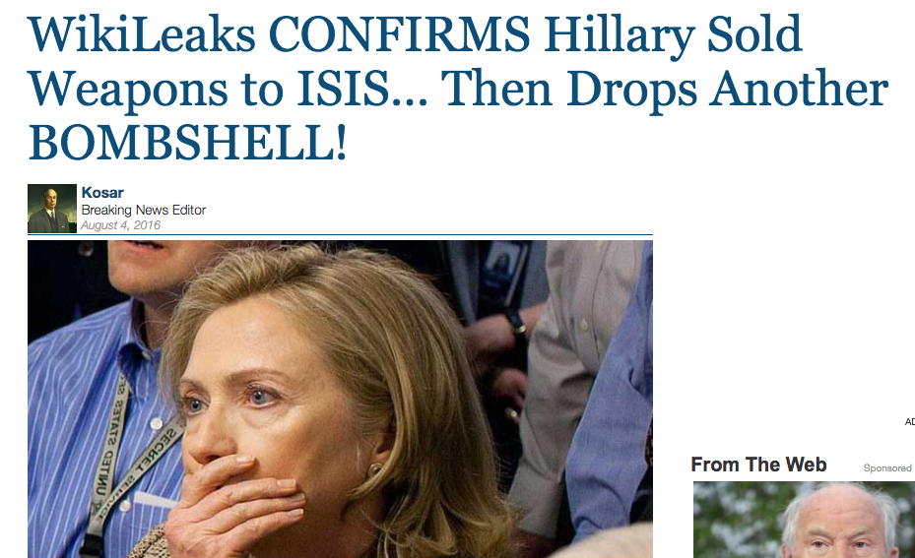

Slide 4
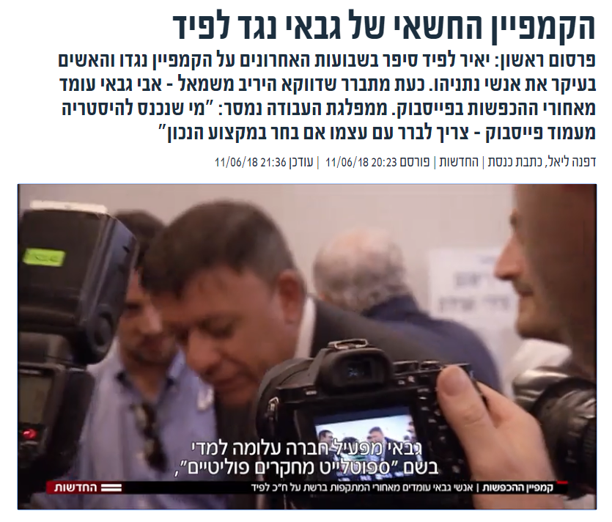

Slide 5


Slide 6


Slide 7
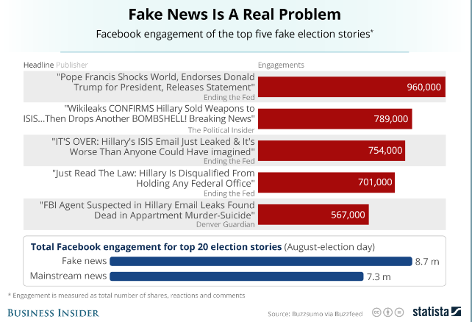
Shares, reactions and comments on Facebook

Slide 8

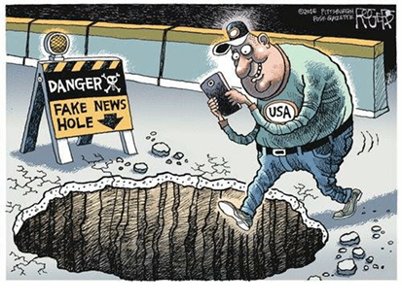
People are not very good in spotting fake news

Slide 9
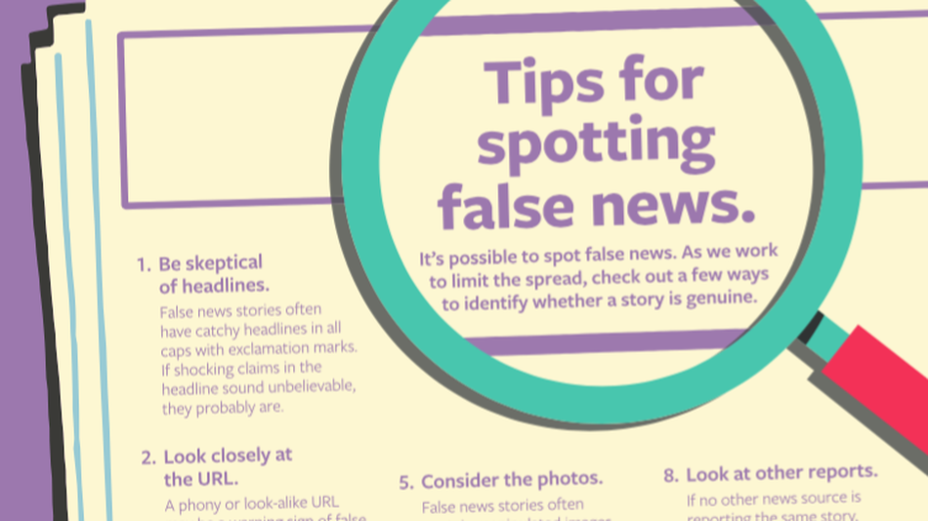
This doesn’t help much…

Slide 10
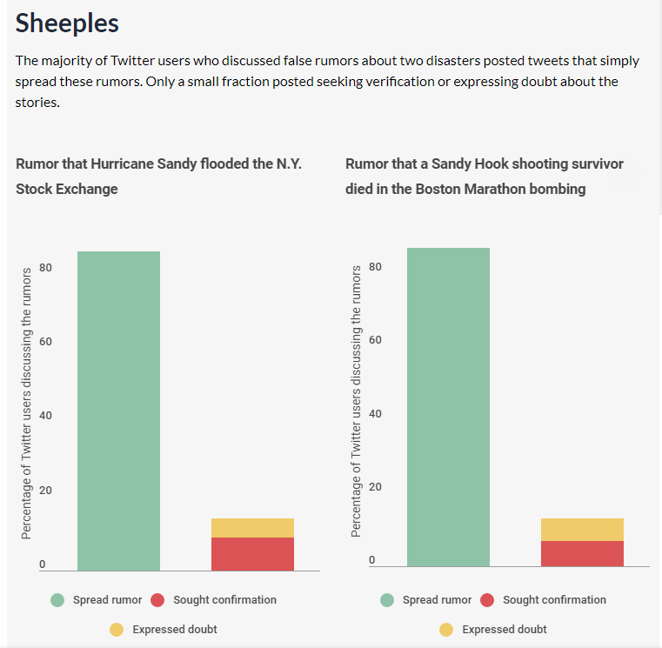
Because people don’t seek confirmation for stories

Slide 11
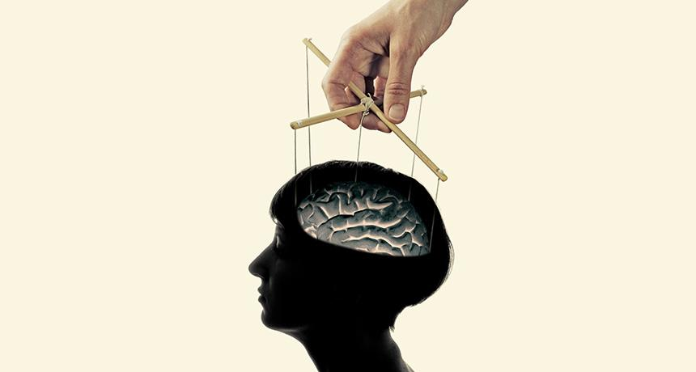
and are to easy to manipulate in the digital era

Slide 12

Fake news evolved into a profession that enjoys the use of many efficient tools and budgets

Slide 13


Slide 14


Slide 15

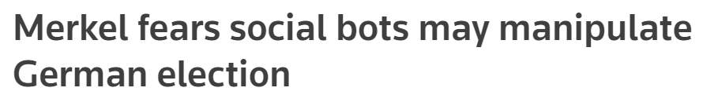

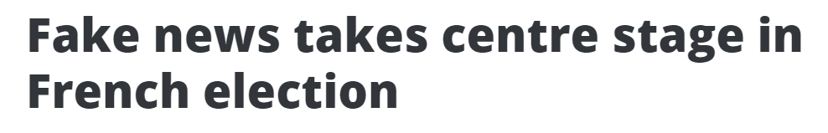
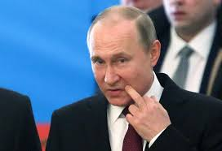
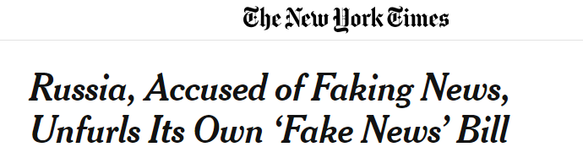

Slide 16




FakeWatch
Yoav Ast
Product Manager Data analyzing and R&D
Yael Szafran Marketing Planning and story telling
Omri Stayer Development
Developer and data analyst

Slide 17
Our vision
Real-time Fake News detection
Protecting Our Society
from manipulation using machine learning algorithms to detect news and news site that are fake!

Slide 18
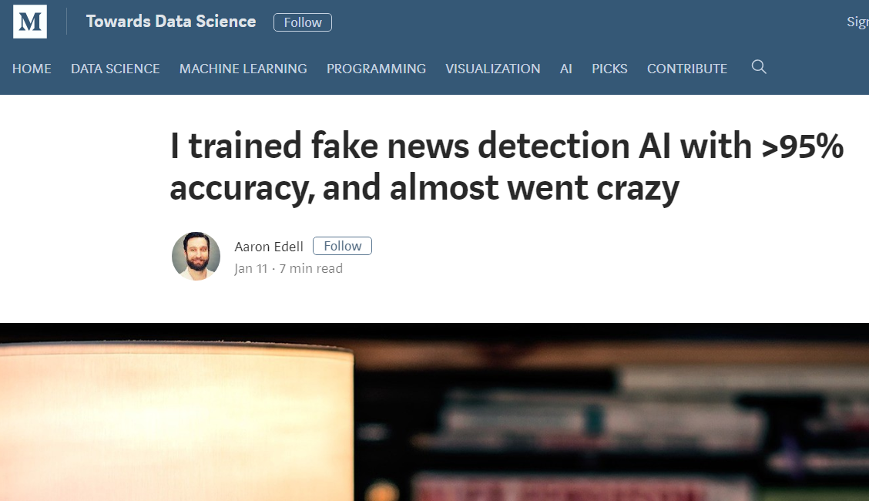
Prior work

Slide 19
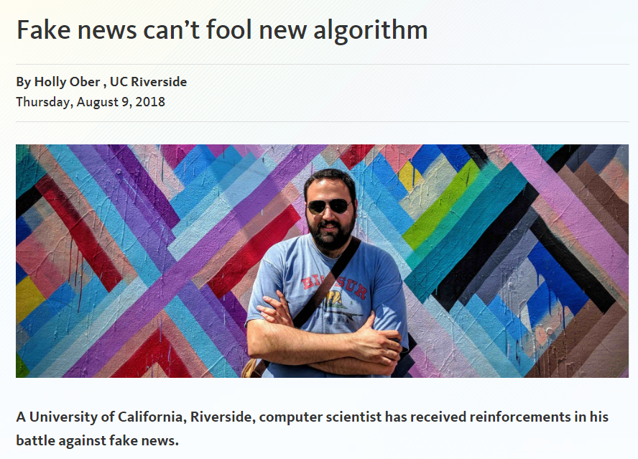

Slide 20
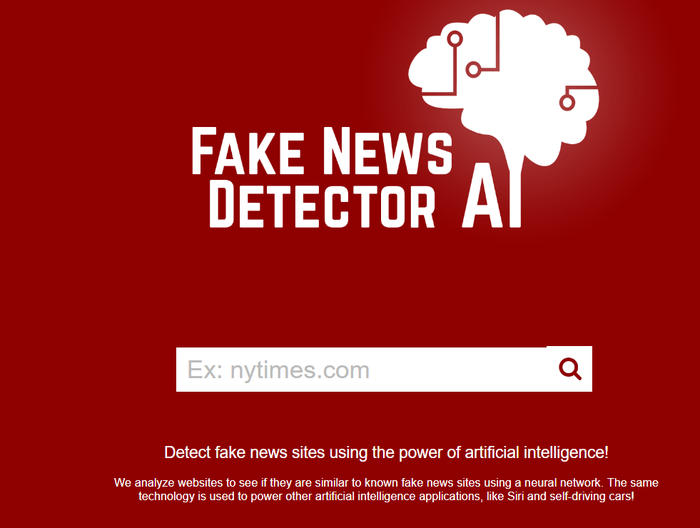

Slide 21
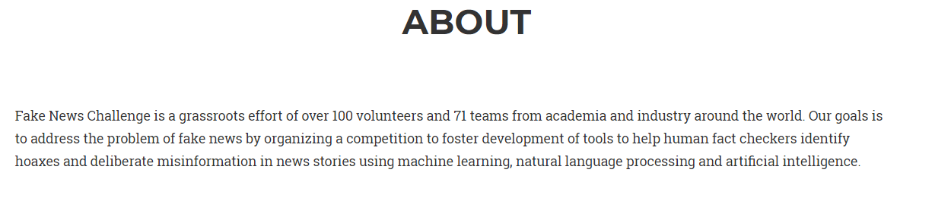
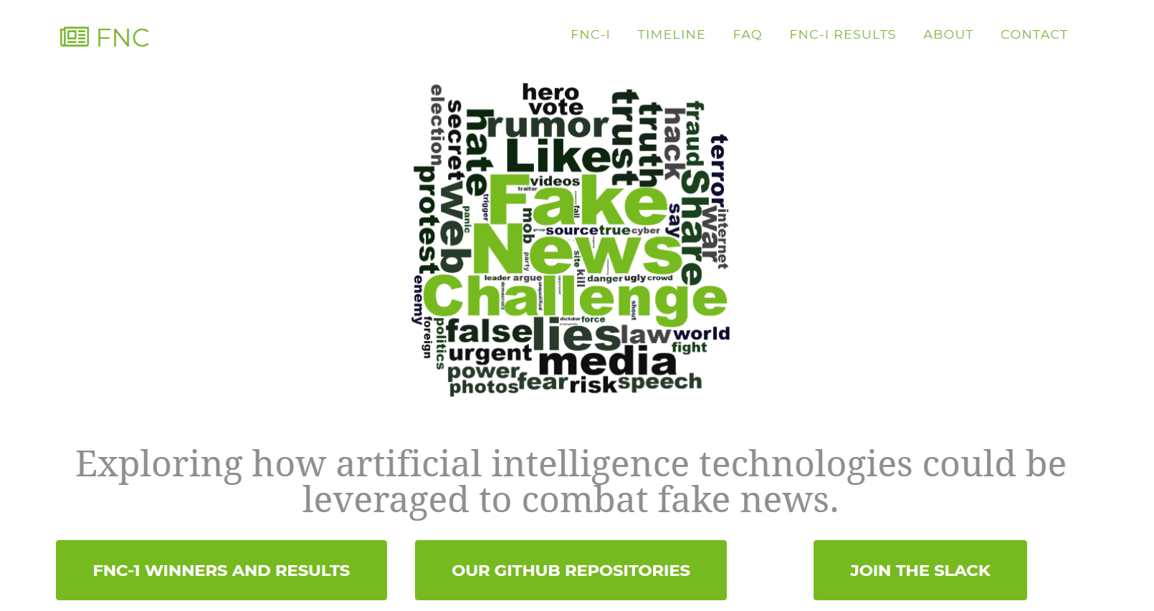

Slide 22
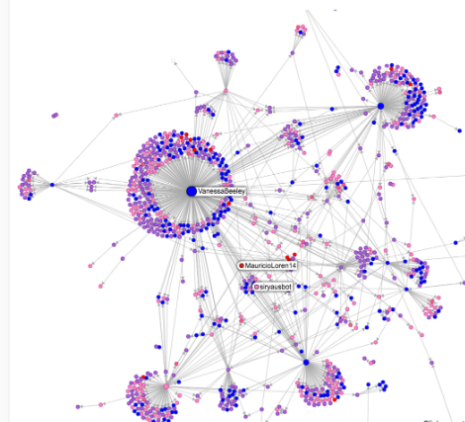

The Business
Website – The FakeWatch barometer. Online live warnings about new fake headlines
Site Grading Algorithim
Chrome Plugin – Fake detector, the FakeWatch Alarm

Slide 23

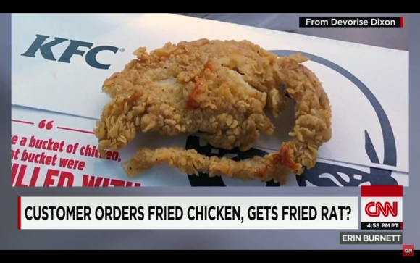


בעלי עניין
Who might be interested in using this kind of protective technology?
Private
Corporate Reputation attacks
Gov
Public opinion manipulation, antisemitism and terror
Social
Fact checkers and people who care about democracy

Slide 24
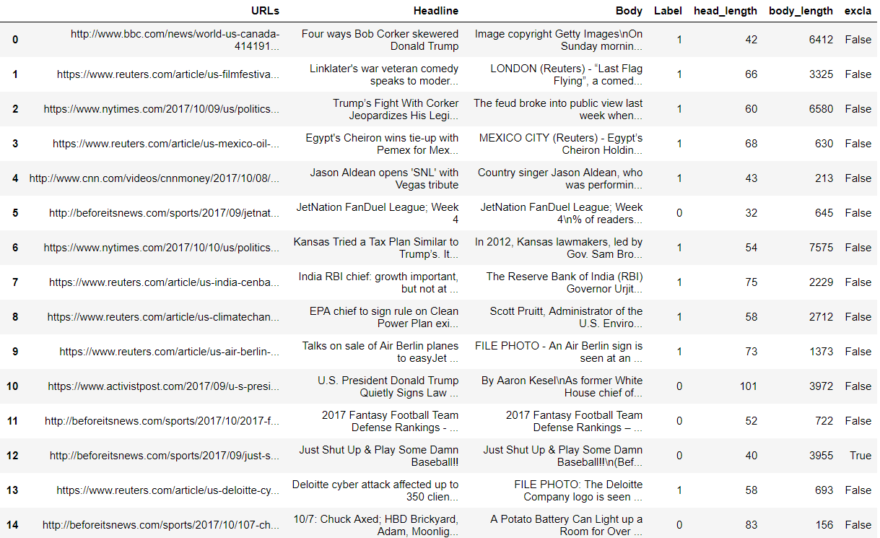
Our Data
Our Data
URL - Site
Headline
Body
Fake?
(0=y, 1=n)
Head&Body Length
“!” in Head

Slide 25
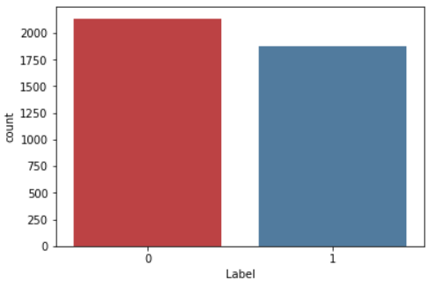
Our Data
We found
4009 Articles
2137
1872
Fake – 53.3%
Real – 46.7%

Slide 26
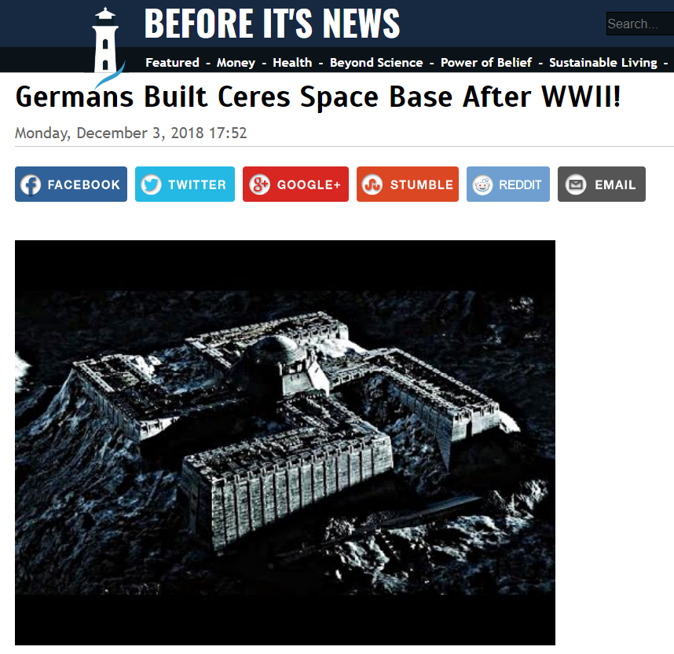
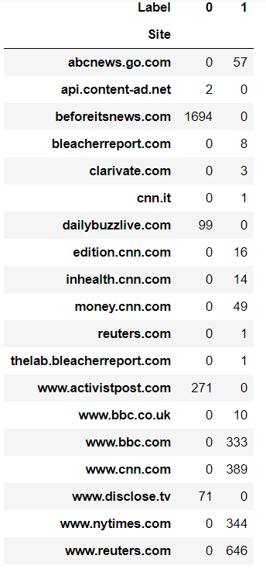
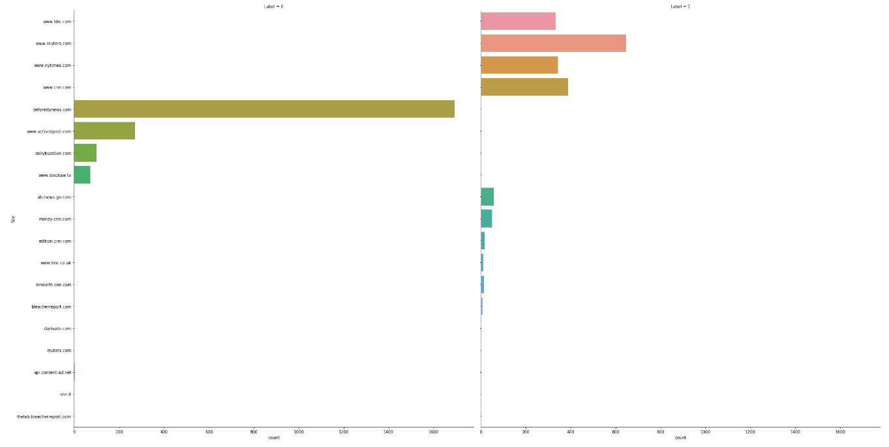
A site is fake or not?
Site Credibility

Slide 27
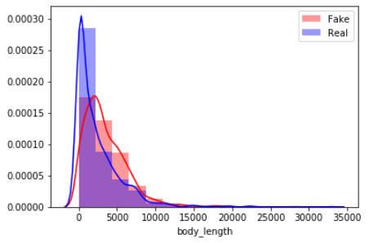
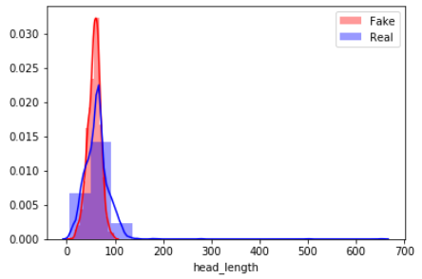
Head & Body Length
Header & Body Length
Body Length
Head Length

Slide 28
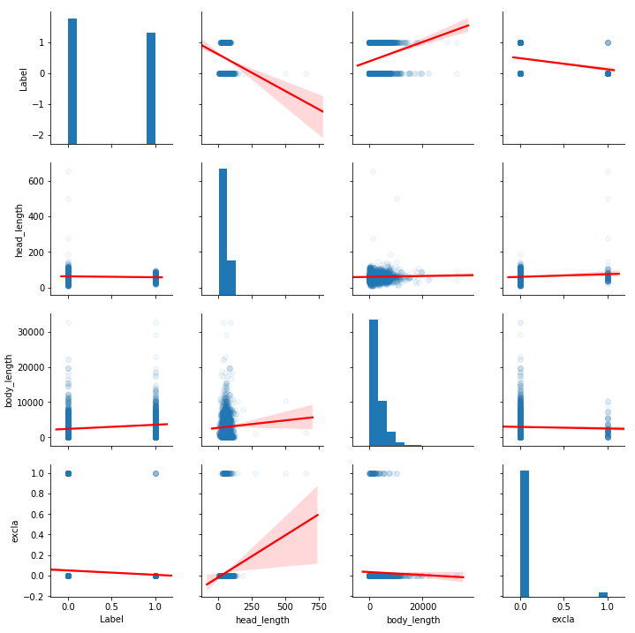
Longer Header with “!” tend to be fake

Slide 29
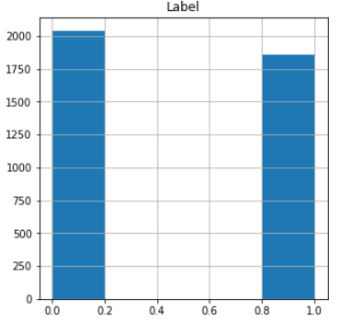
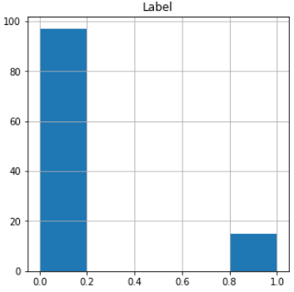
“!” in Header
Without “!” in Text
With “!” in Text
Header Without ”!”
Header With ”!”
87% Fake

Slide 30
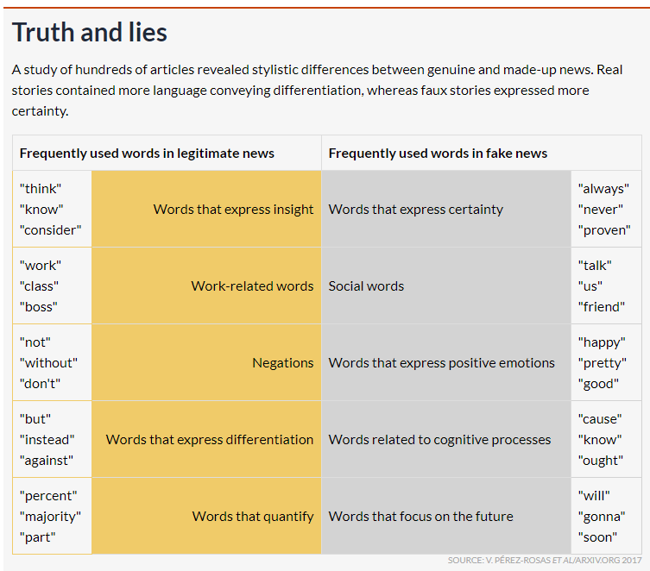
More Parameters that can be tested

Slide 31
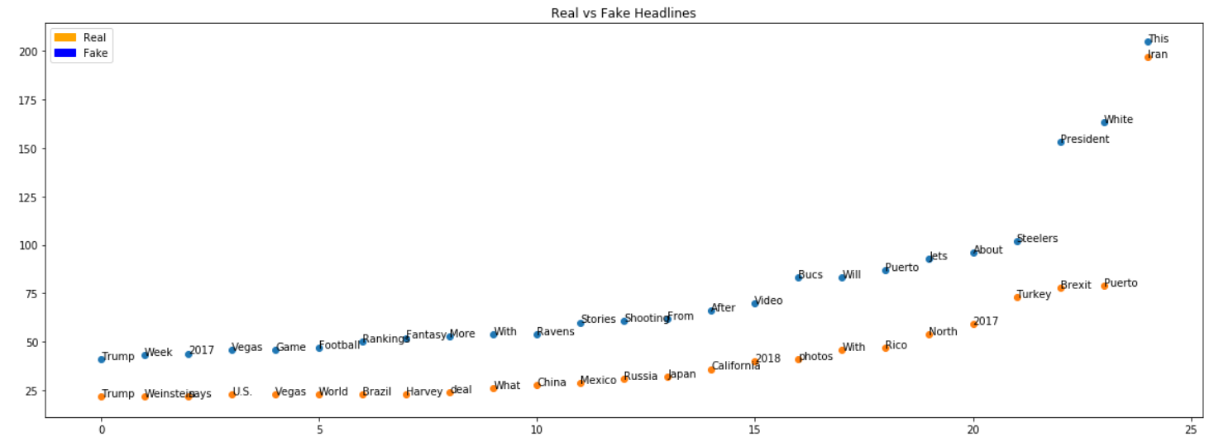
Frequently Used Words

Slide 32
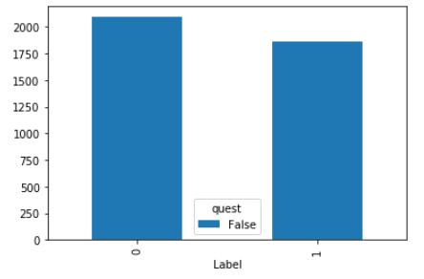
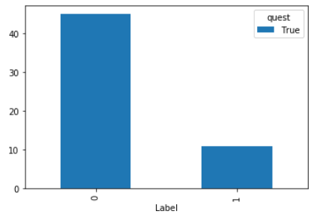
Frequently Used Words
“President” in the beginning of heading
80% Fake
Fake
Real
Fake
Real
Without President
With President

Slide 33
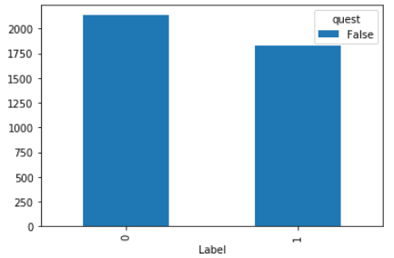
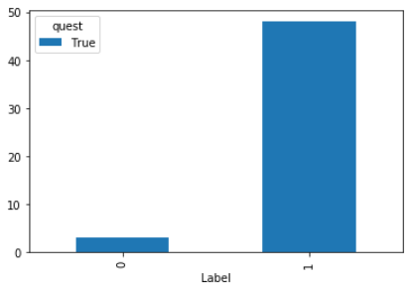
Frequently Used Words
“new” in the heading
94% Real
Fake
Real
Fake
Real
Without “new”
With “new”

Slide 34
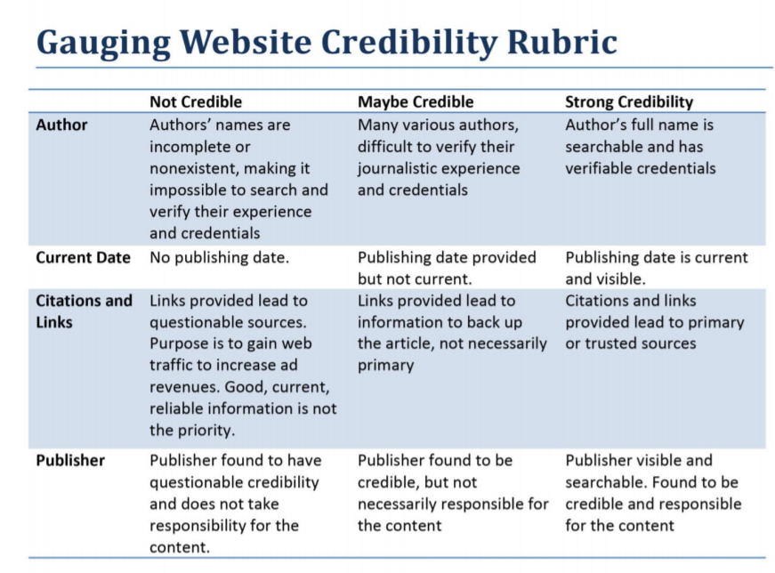

Slide 35
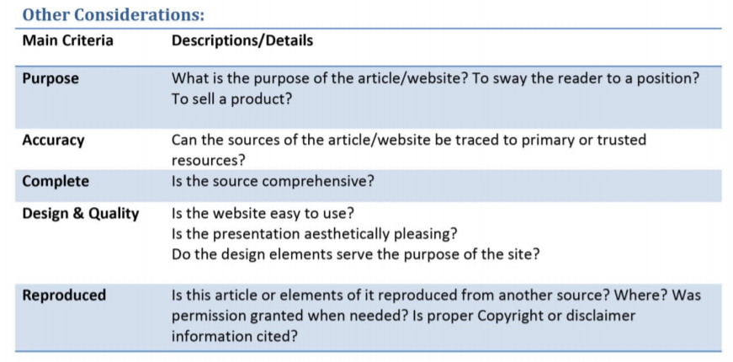

Slide 36

DATA
bases

Slide 37

Thank You

